Slide 1
Regular Expression
School of infocomm

Slide 2

Text
SUNNY DAY
Building blocks of written language are the symbols such as the alphabets
A text can be viewed as an arrangement of symbols organized in an intentional and meaningful way
E.g R, O, M, T, S ➔ ROMTS ???
➔ STORM ✓✓✓
Notes:
none

Slide 3
Structure in Text
Entities such as company names or names of people
Date formats
Email message structure - header followed by subject followed by body
Visual structure such as tables
Markup such as HTML or XML
Notes:
none

Slide 4
What are Regular Expressions (RegEx)?
To understand text, we need mechanism for analysing its contents, markups and format
Regular expressions is the starting point
A regular expression a specialist notation used to describe string patterns that we want to match
Example :
Notes:
a specialised notation for describing patterns that we want to match.

Slide 5
Use Cases for RegEx
Parsing documents with structured layout
- HTML, find all text within <p> and </p>tags
Handling personal identifiable information (PII)
- Is there something in the text that looks like NRIC?
Find logical "cut point" of huge corpus of document
- Find start and end of sentences
Replace unwanted characters or hidden text encoding
- Line breaks
remove/replace unwanted characters
Notes:
none

Slide 6
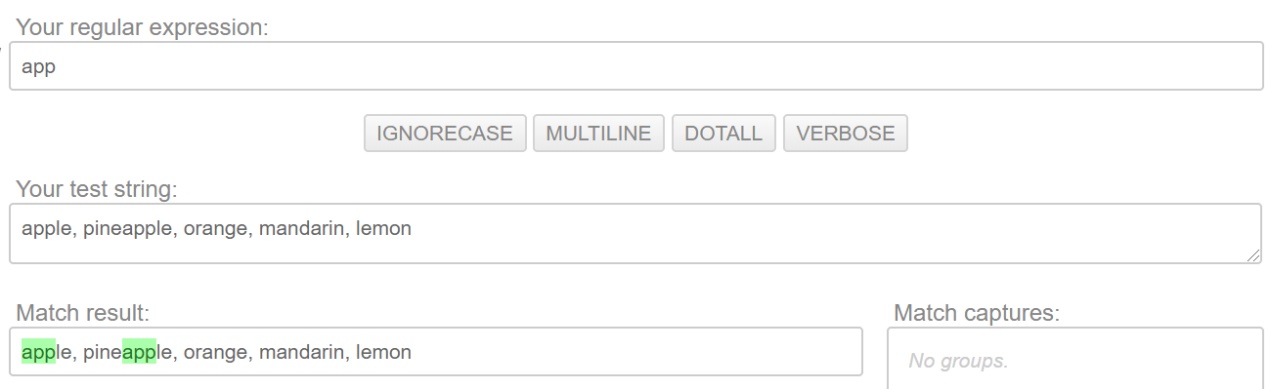
https://pythex.org/
Your First Regular Expression
Matching fixed strings
https://pythex.org/
Notes:
Reference website https://pythex.org/
List of fruits: Apple, Pinapple, Orange, Durian, Lemon,

Slide 7
Special Sequence / Symbols
\d | Digits in 0123456789
\D | Non-digits
\w | Letters, digits and _
\W | Non-words
\t | tab
\n | new line
\r | Return
\s | White spaces, including tabs, new lines , return
* The backslash is an escape character
Notes:
Reference website https://pythex.org/
List of fruits: Apple, Pinapple, Orange, Durian, Lemon,

Slide 8
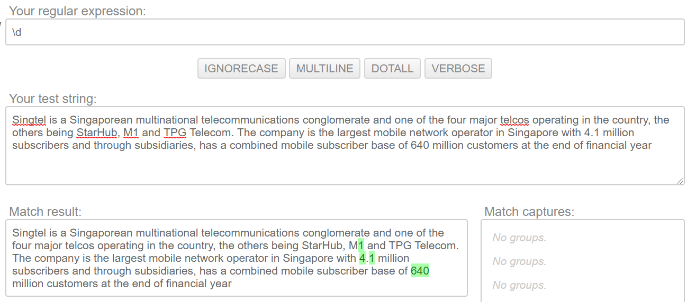
Finding numbers in text (Attempt #1)
Notes:
Singtel is a Singaporean multinational telecommunications conglomerate and one of the four major telcos operating in the country, the others being StarHub, M1 and TPG Telecom. The company is the largest mobile network operator in Singapore with 4.1 million subscribers and through subsidiaries, has a combined mobile subscriber base of 640 million customers at the end of financial year .
https://pythex.org/

Slide 9
Boundaries
Boundaries characters are used to ‘anchor’ a pattern to some edges
\b | Word boundaries
\B | Non-word boundaries
^ | Beginning of line
$ | End of line
Notes:
Sunday, Monday, Tuesday, Wednesday
Thursday, Friday, Saturday
Seven days are in a week
I like to sing them quiet
.

Slide 10
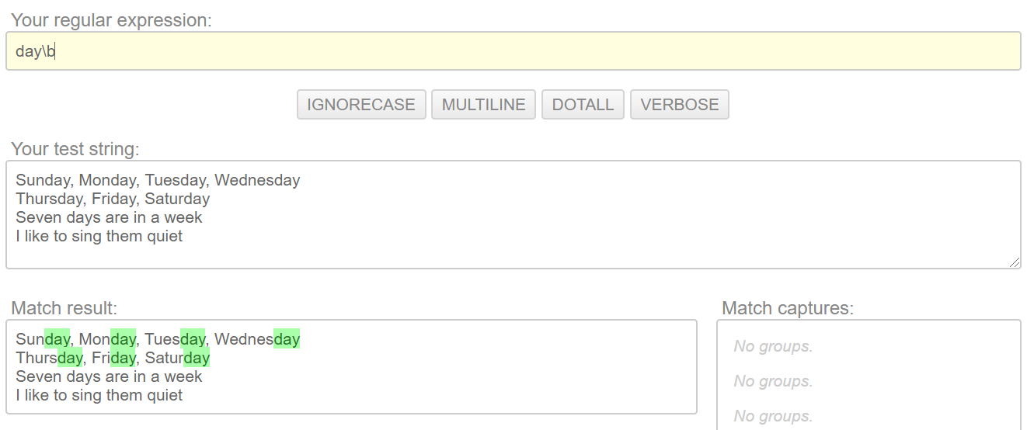
Matching fixed strings patterns found at a word boundary
“day\b” – find word breaks (\b) ending with day
Notes:
Sunday, Monday, Tuesday, Wednesday
Thursday, Friday, Saturday
Seven days are in a week
I like to sing them quiet
.

Slide 11
Qualifiers (1)
X* | 0 or more repetitions of pattern X
X+ | 1 or more repetitions of pattern X
X? | 0 or 1 instances of pattern X
Notes:
Reference website https://pythex.org/
List of fruits: Apple, Pinapple, Orange, Durian, Lemon,

Slide 12
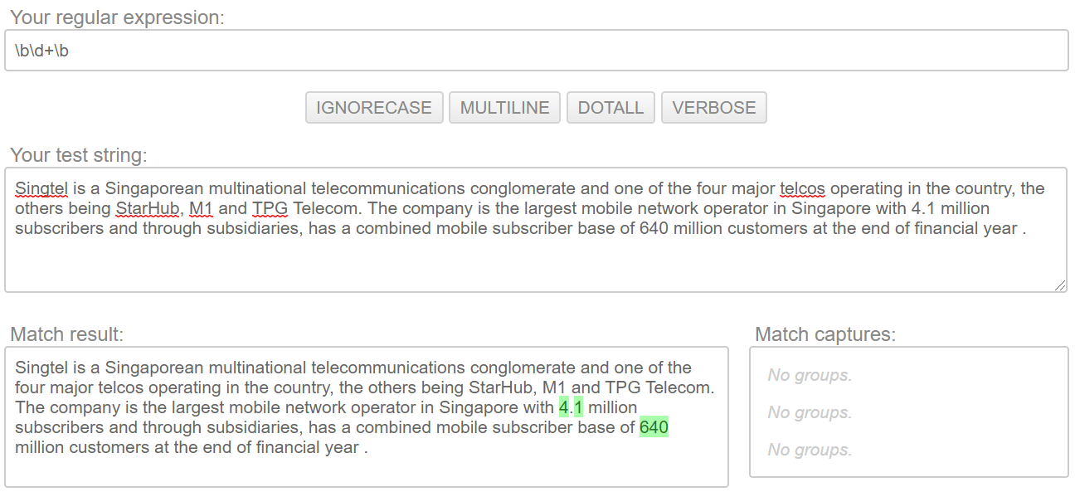
Finding numbers in text (Attempt #2)
If you look closely, 4.1 was not identified
Notes:
Singtel is a Singaporean multinational telecommunications conglomerate and one of the four major telcos operating in the country, the others being StarHub, M1 and TPG Telecom. The company is the largest mobile network operator in Singapore with 4.1 million subscribers and through subsidiaries, has a combined mobile subscriber base of 640 million customers at the end of financial year .

Slide 13
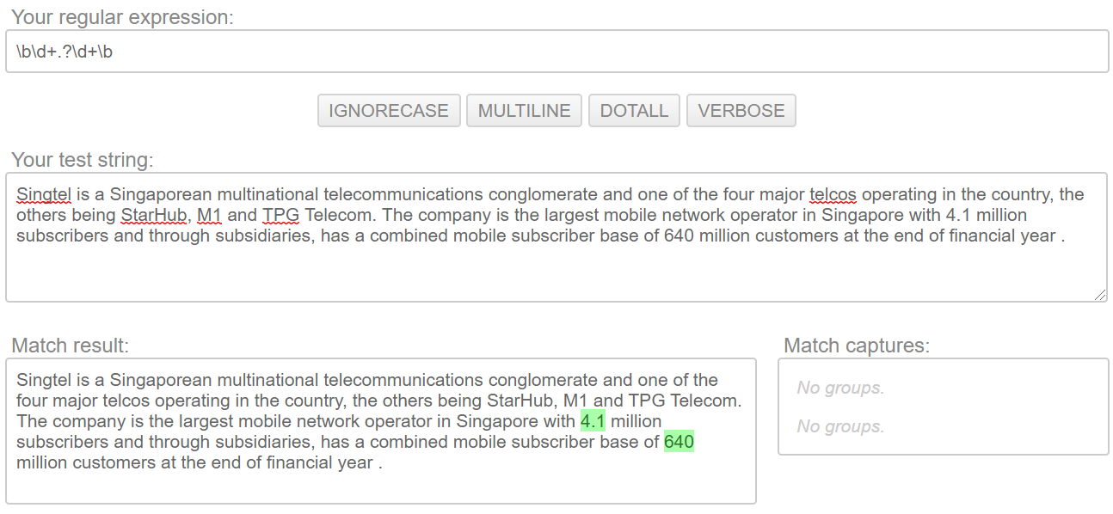
Finding numbers in text (Attempt #3)
4.1 is identified
Notes:
Singtel is a Singaporean multinational telecommunications conglomerate and one of the four major telcos operating in the country, the others being StarHub, M1 and TPG Telecom. The company is the largest mobile network operator in Singapore with 4.1 million subscribers and through subsidiaries, has a combined mobile subscriber base of 640 million customers at the end of financial year .

Slide 14
Qualifiers (2)
X{m} | Exactly m instances of X
X{m, n} | Between m and n instances of X
X{m, } | At least m instances of X
Notes:
Reference website https://pythex.org/
List of fruits: Apple, Pinapple, Orange, Durian, Lemon,

Slide 15
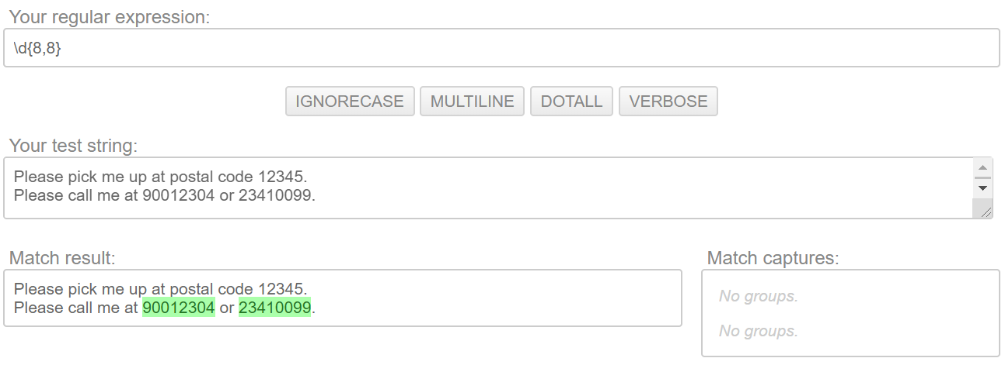
Finding numbers with certain size
Notes:
Please pick me up at postal code 12345.
Please call me at 90012304 or 23410099.

Slide 16
Characters Class
[ …….. ]
Use to express a set of choices between individual characters
[arn] | Returns a match where one of the specified characters (a, r, or n) are present
[a-n] | Returns a match for any lower case character alphabetically between a and n
[0123] | Returns a match where any of the specified digits (0, 1, 2, or 3) are present
[0-9] | Returns a match for any digit between 0 and 9
[0-5][0-9] | Returns a match for any two-digit numbers from 00 and 59
Notes:
Reference website https://pythex.org/
List of fruits: Apple, Pinapple, Orange, Durian, Lemon,

Slide 17
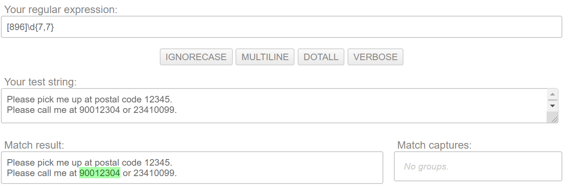
Finding numbers with certain size AND some pattern
Notes:
Please pick me up at postal code 12345.
Please call me at 90012304.
.

Slide 18
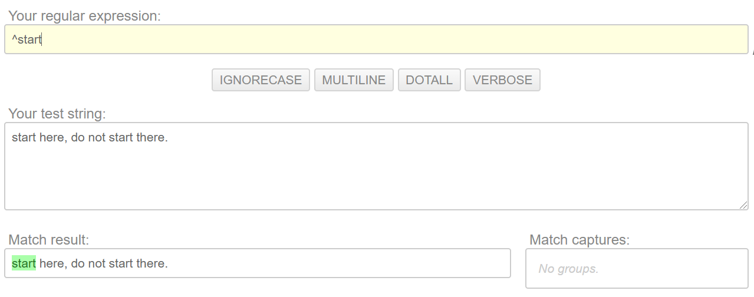
Find a sentence starting with a pattern
Notes:
Start here, do no there there

Slide 19
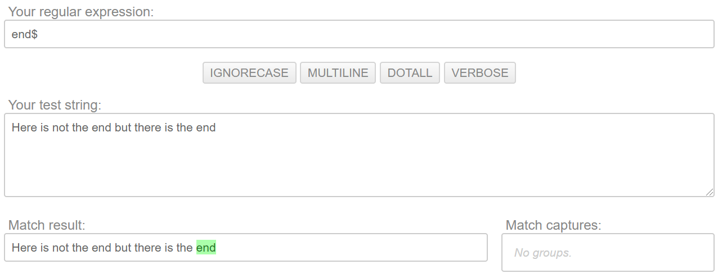
Find a sentence ending with a pattern
Notes:
Here is not the end but there is the end

Slide 20
Scoping / Group
( ….)
Use to express a sequence of symbols that must be together
(abc) | Returns a match that contains ‘abc’
(abc)+ | Returns a match that contains abc or abcabc or abcabcabc
Notes:
Reference website https://pythex.org/
List of fruits: Apple, Pinapple, Orange, Durian, Lemon,

Slide 21
Conditions (alternatives)
|
Use to express matches with two or more regular expression
X | Y | Returns a match that contains pattern X or pattern Y
X | Y | Z | Returns a match that contains pattern X or pattern Y or pattern Z
Notes:
Reference website https://pythex.org/
List of fruits: Apple, Pinapple, Orange, Durian, Lemon,

Slide 22
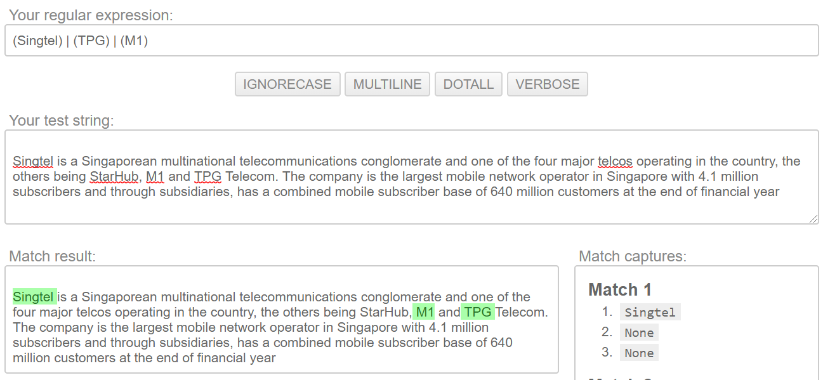
Find some mentions of names

Slide 23
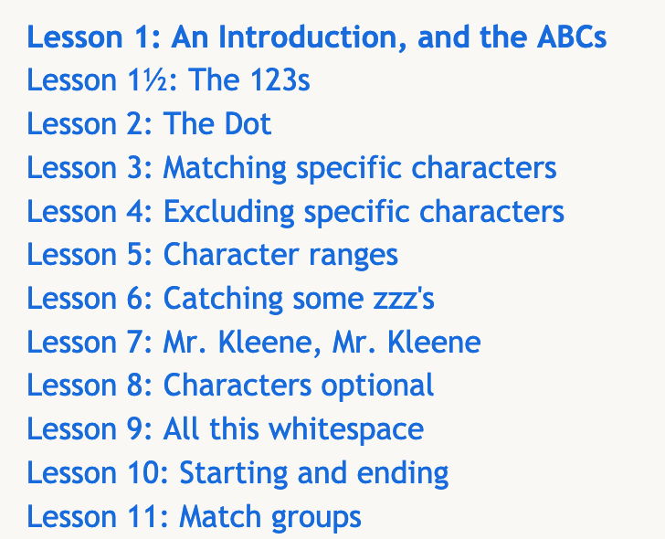
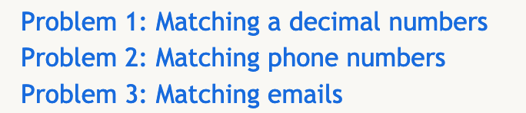
Exercise
https://regexone.com/
Appreciation of RegEx syntax
Instructions:
Complete Lesson 1 to Lesson 12.
Complete Problem 1 to Problem 3.
Check the solution only if you must
Notes:
We are going to use the remaining of the time to get our self familiar with regular expression.
We will first start with you getting use to the syntax of the RE. Generally, the syntax is language independent. So when you figure out for Python, you can easily apply to another language.
(30 mins)
The, we look at the RE module in Python. We will focus on using some of the common methods found the RE to perform search and subsititute methods.
(30 mins)
Finally, we look into how we can use RE to perform some preliminary understanding of a corpus of text.
(30 mins)

Slide 24
Regex Related Tasks
Many languages allow programmers to define regex and then use them to:
Validate that a piece of text (or a portion of that text) matches some pattern
Find fragments of some text that match some pattern
Extract fragments of some text
Replace fragments of text with other text
Notes:
This example would search the variable text for occurrences of the pattern ‘Sherlock Holmes’.
Re.compile returns a regular expression object

Slide 25
Regular Expression in Python
Module re – standard Python library that provides text processing services
Both patterns and strings to be searched can be Unicode (strings) as well as 8-bit strings (bytes)
Backslash character ('\') to indicate special forms or to allow special characters to be used without invoking their special meaning
Notes:
This example would search the variable text for occurrences of the pattern ‘Sherlock Holmes’.
Re.compile returns a regular expression object

Slide 26
Search Method
re.search(pattern, string):
Scan through string looking for the first location where the regular expression pattern produces a match and return a corresponding match object
The match object contains information about the search and the result.
.span() returns a tuple containing the start and end positions of the match. .group()returns the part of the string where there was a match
.string returns the string passed into the function
Notes:
This example would search the variable text for occurrences of the pattern ‘Sherlock Holmes’.
Re.compile returns a regular expression object

Slide 27
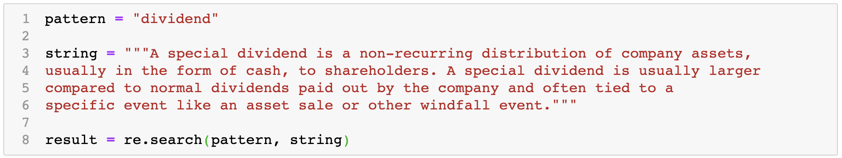
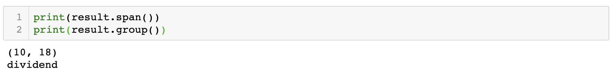
Example 1A
Refer to notebook : re-example-1

Slide 28
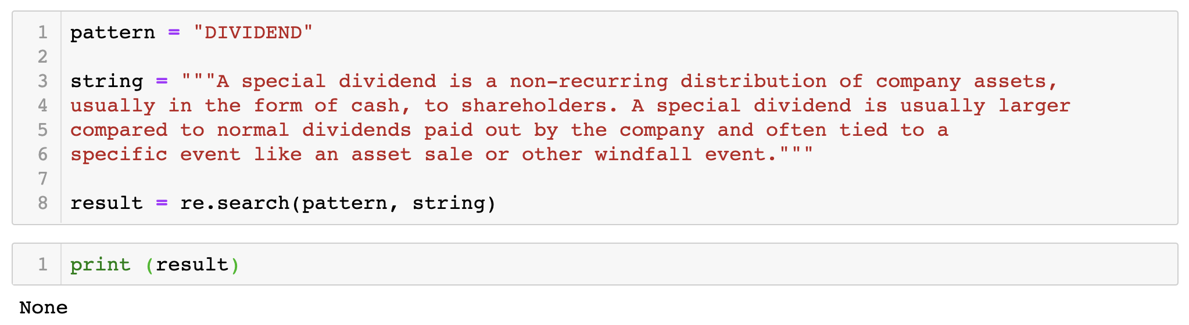
Example 1B
In this example, the match object is None because ____________________________

Slide 29
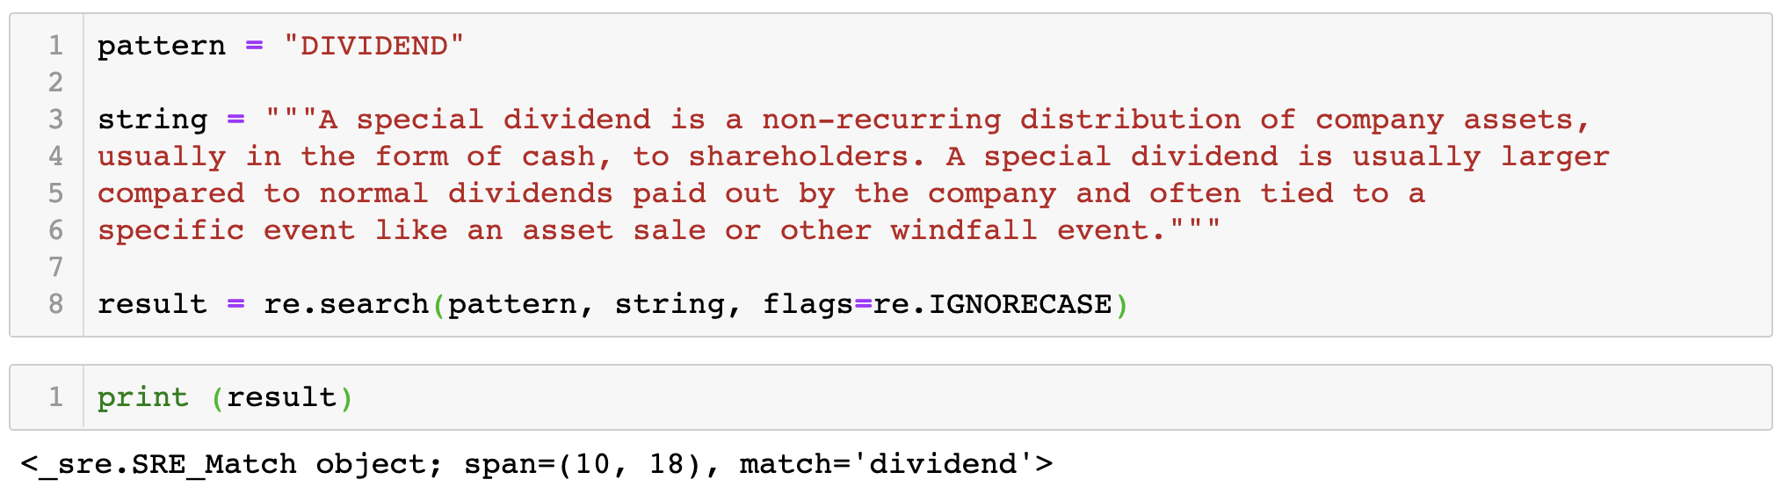
Example 1C
In this example, the flag ____________________ is passed into the .search() method to tell RE to ignore case differences

Slide 30
Findall Method
re.findall(pattern, string):
Scan through string looking for all matches of the regular expression pattern and return a list of text fragments that match the pattern
Notes:
This example would search the variable text for occurrences of the pattern ‘Sherlock Holmes’.
Re.compile returns a regular expression object

Slide 31
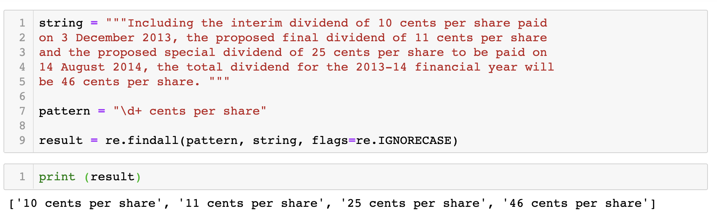
Example 2
Refer to notebook : re-example-2

Slide 32
Compiling Regular Expression
A regex can be compiled into an object that can be used for faster validation, extraction, and replacing.
The text to be processed is then passed into the compiled object by calling its associated methods such as findall(), search()
This is useful when we need to apply the RE to many rows of text data in a Data Frame

Slide 33
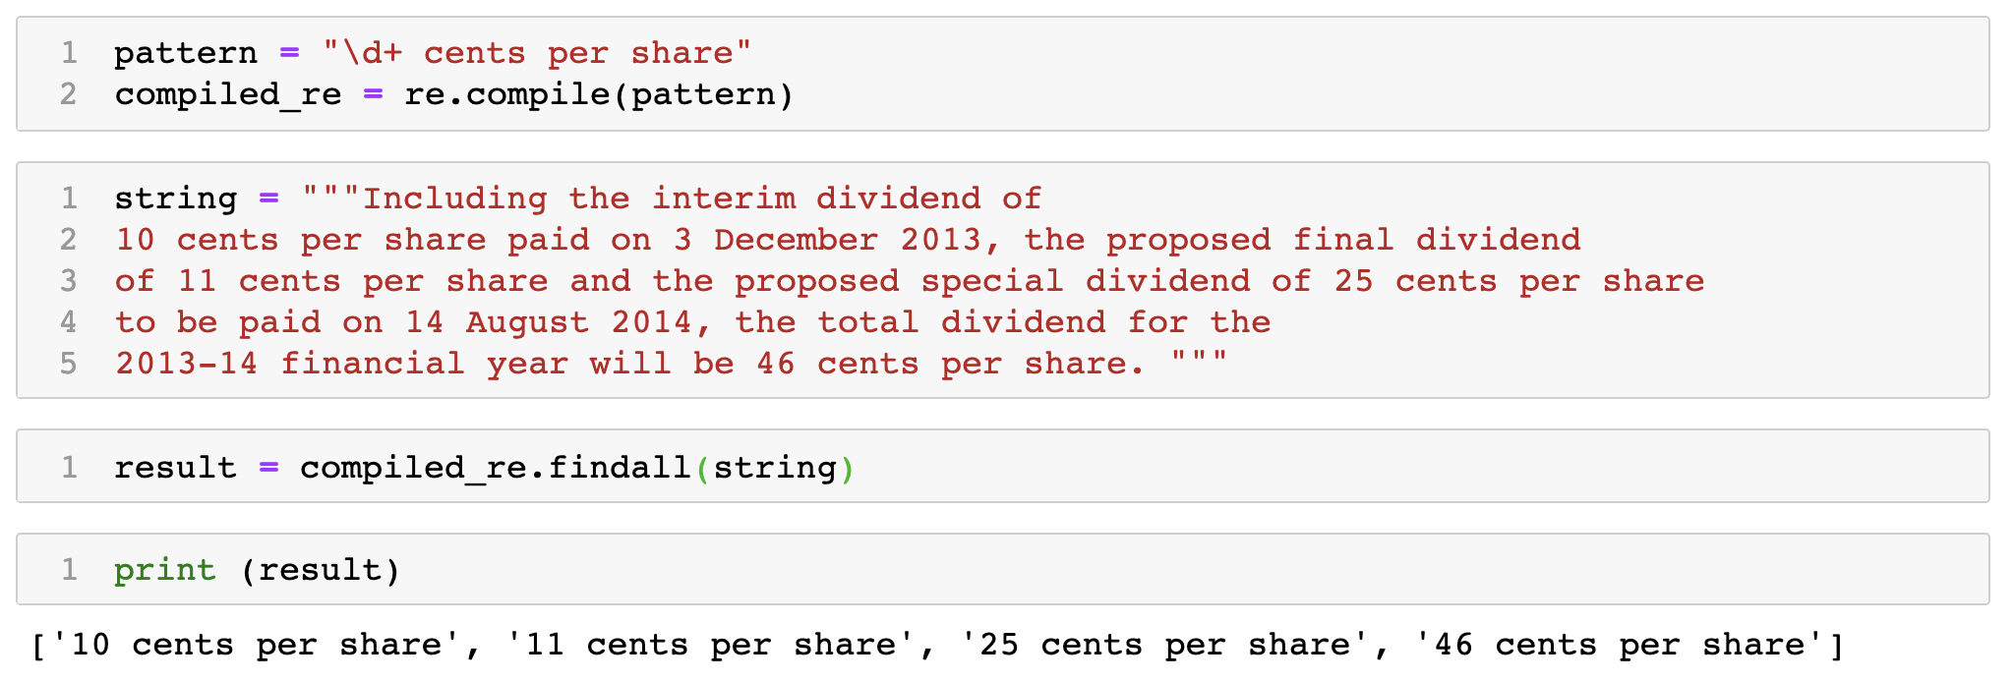
Example 3A
Refer to notebook : re-example-3

Slide 34
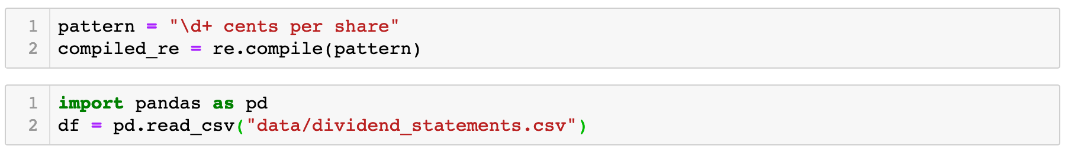
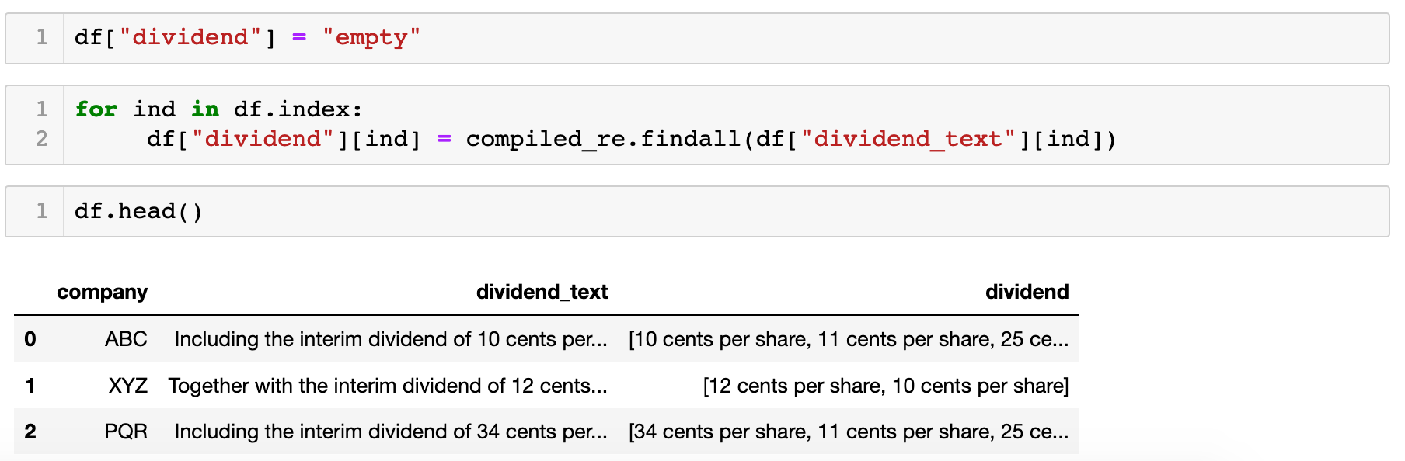
Example 3B
Compiling a regular expression is useful when the same regular expression is applied across multiple strings.

Slide 35
Substitute Method
re.sub(pattern, replace_string, string):
Use to replace occurrences of a particular sub-string (pattern) with another sub-string (replace_string) and to return the new string.
Use case: mask out sensitive information from text
Notes:
This example would search the variable text for occurrences of the pattern ‘Sherlock Holmes’.
Re.compile returns a regular expression object

Slide 36
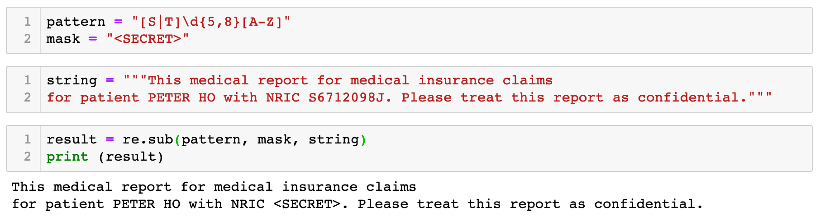
Example 4
Refer to notebook : re-example-4

Slide 37
Split Method
re.split(pattern, string):
Use to split string by the occurrences of pattern. It returns a list of the various text segments of the original string.
Use case: break huge amount of text into smaller text segments

Slide 38
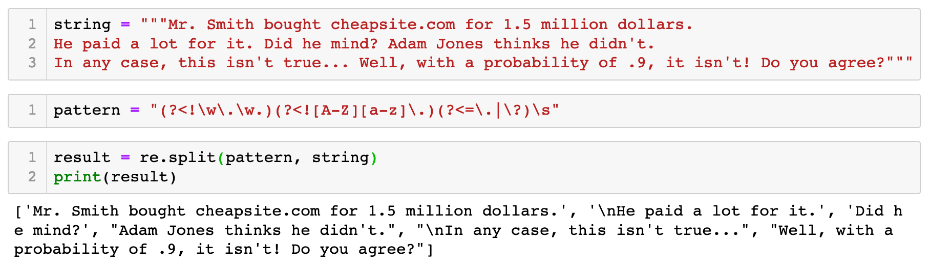
Example 5
How do you remove the \n from the result?
Refer to notebook : re-example-5

Slide 39
Common Problem – meta characters in text
It is a smilie :) Many people are too lazy to type it. Multiple "))))" do not mean laughing, it's just a more friendly smile. :))
The text above carries a special meta character ).
How do we search for the smilie?
If we are not careful in writing the regular expression, it can be interpreted as the close of a parameter or perform special function.
Use \ to inhibit the "specialness" of a character. If you are unsure if a character has special meaning, you can put a slash in front of it, such as \), to make sure it is treated just as a character.

Slide 40
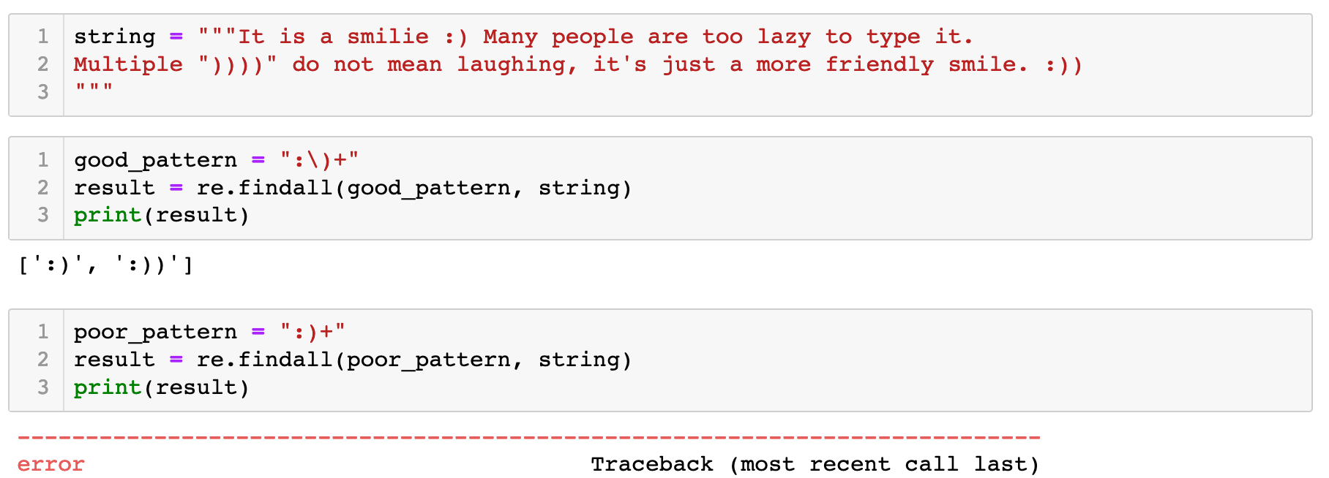
Example 6
With Escape \
Without Escape \
Refer to notebook : re-example-6

Slide 41
Exercise
Proceed with Jupyter Notebook
re-ex-sherlockhomes.ipynb
Use regular expression to gain preliminary insights into a large corpus of data

Slide 42
Optional Video
Regular Expressions Lecture — [ NLP || Dan Jurafsky || Stanford University ] - https://youtu.be/EyzTQ0OKeNw
Regular Expressions in Practical NLP - https://youtu.be/k242_PpMEsQ

Slide 43
References
Python RE module documentation, https://docs.python.org/3/library/re.html
Regular expression in Python, https://www.w3schools.com/python/python_regex.asp
Python Regular Expressions, https://developers.google.com/edu/python/regular-expressions

